Slide 1


Professor S. Chan Choi
Course: Marketing Research
Presented by:
Hardik Poojary
Heena Mansoori
Sagar Desai
Sakshi Kalani
Vamshi Katta

Slide 2





Introduction
Uber is a peer-to- peer ridesharing, food delivery, and transportation network company headquartered in San Francisco, California with operations in 633 cities worldwide.
Its platforms can be accessed via its websites and mobile apps.
Currently, Uber is testing its self- driving cars in a fake city it built in Pittsburg called Almono.
Self - driving cars have the potential to save millions of lives and to improve the quality of life for people around the globe.
1.3 million people die everyday in car accidents - 94% of those accidents involve human error. Uber’s mission is to make autonomous transportation reliable for everyone and everywhere.

Slide 3




Problem Definition
Primary Goal : To determine the consumer acceptance of Uber’s Self - driving cars in market | Secondary Goals : The willingness of the consumers to pay for the self - driving car services Biggest security concerns of the consumers | Secondary Goals : Companies consumers trust to introduce self - driving cars

Slide 4


Research Design and Data Collection
Qualitative Research : Secondary data analysis was done by finding relevant information available online.
Quantitative Research :
Google Forms was used to create a survey. The respondents were given a link through which they are redirected to the questionnaire on the Google Forms website.
Respondents’ responses are saved on the Google Forms website which can be viewed/downloaded. Sample size of this survey was 150. Survey consisted of 18 questions which were a mixture of multiple choice, checkboxes, nominal and likert scale questions.

Slide 5
Qualitative Research
As per research done by World Economic Forum respondents in India followed by China, UAE, France and USA are most likely to try self driving cars.
According to research conducted by Deloitte, 73% of the respondents feel that self- driving cars will not be safe.
68% of them are comfortable sharing their personal information with automotive manufacturer or dealer.
63% of them feel the fear of hacking into the car and eventual risk of personal safety.
53% of them would trust a traditional car manufacturer to bring driverless car to market.

Slide 6

Quantitative Research - Data Analysis
Dependent Variables:
Likelihood that a consumer will ride Uber’s self-driving cars?
Independent Variables:
5 - 10% less than current rate Safety consequences Traditional Car Manufacturers
0 -5% less than current rat Data privacy New Autonomous Car Companies
Same as the current rat Not driving as well as human Existing Technology Company
0 - 5% more than current rate Learning to use self-driving cars Others (Ex. Uber, Lyft)
5 - 10% more than current rate Performance in poor weather
Pricing
Concern
Trust

Slide 7
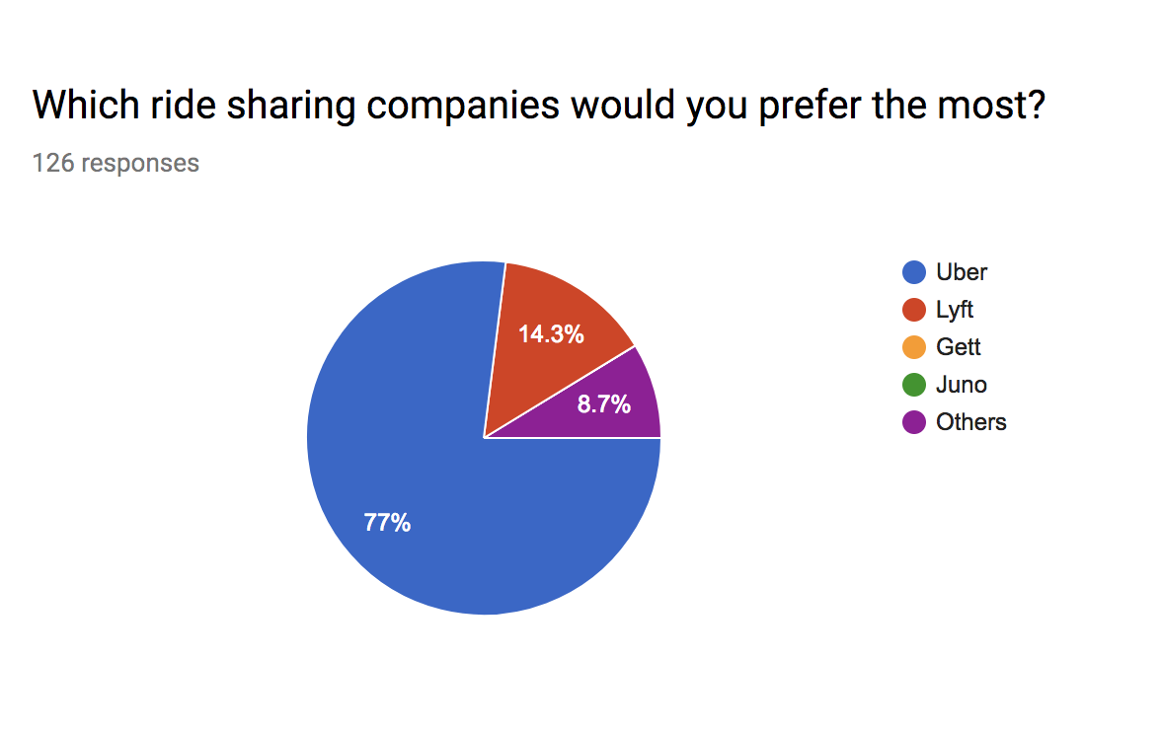
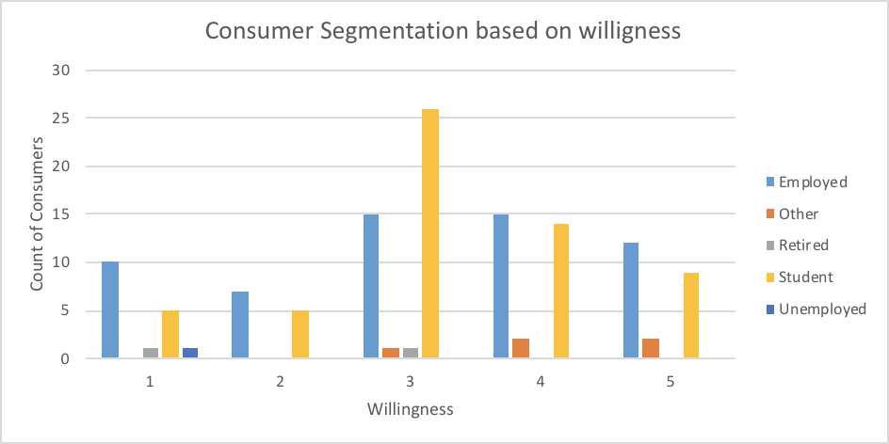
Data Analysis
As can be seen, after cross tabulation we can say that majority of the students are neutral about this drive but the employed population graph is frequent throughout with more towards the likelihood side.
Uber stands tall against its competitors when it comes to the most preferred ride sharing companies.

Slide 8
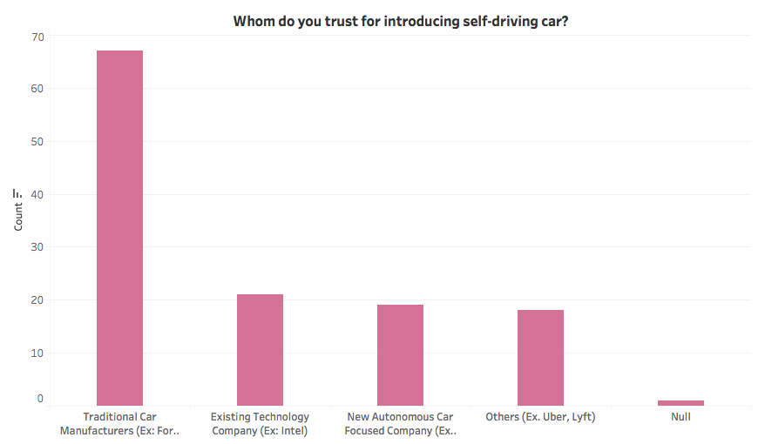
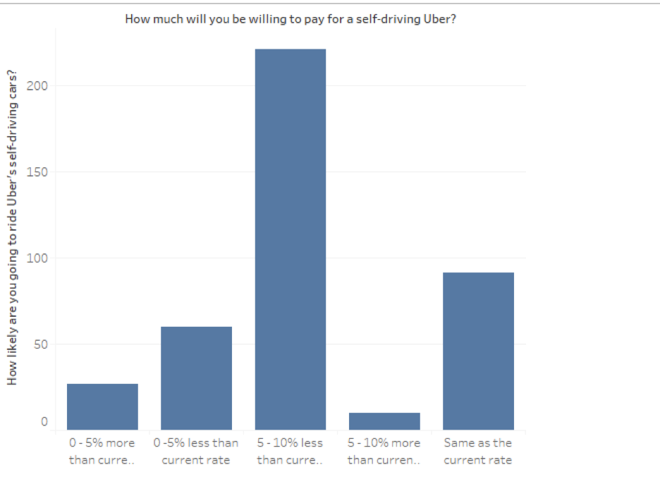

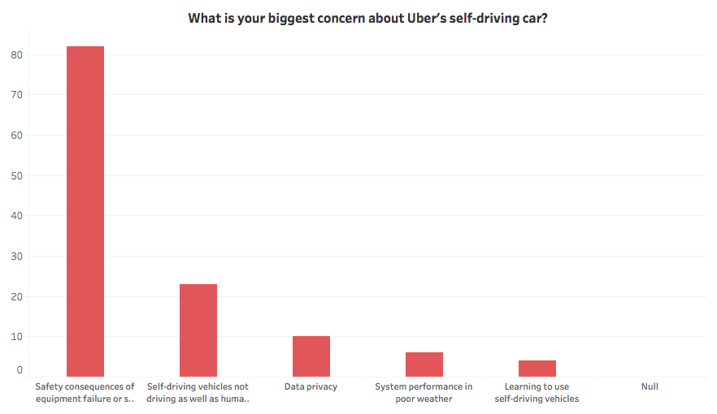
Data Analysis
Independent Variables
Concern
Trust
Pricing

Slide 9
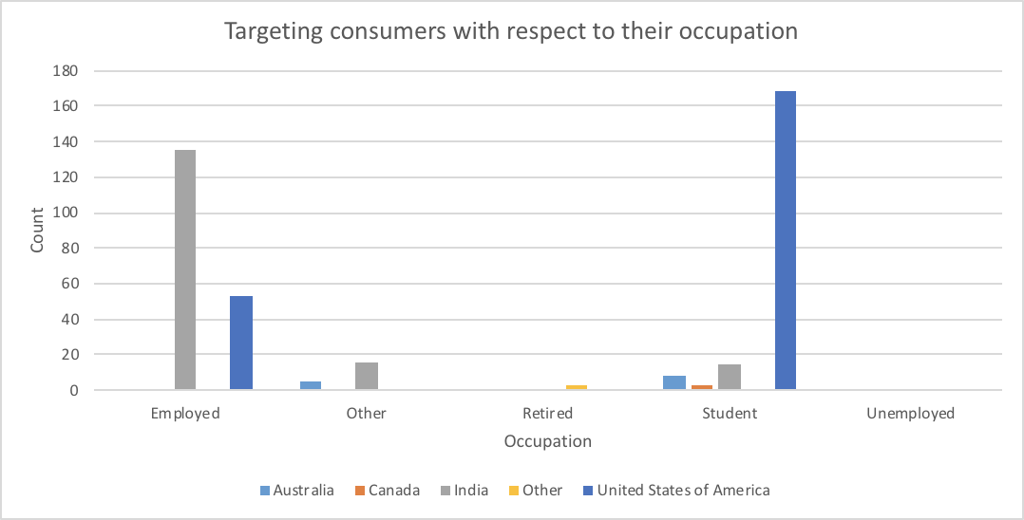
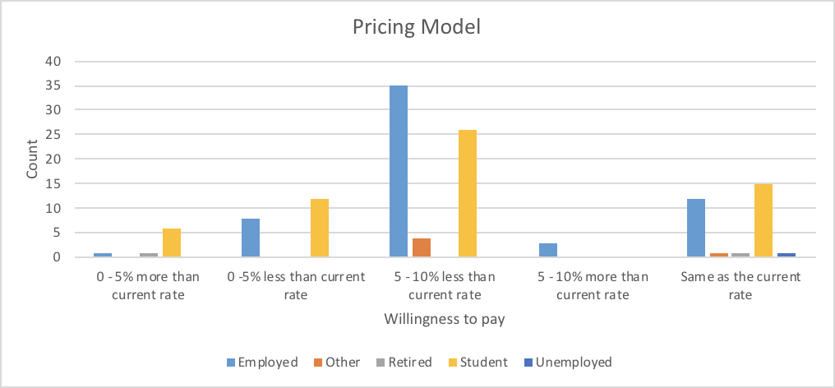
Data Analysis
But when it comes to shelling out money, ironically the very same group also has the maximum number who would pay upto 10% less than the current amount.
We can conclude that with the results obtained from the conducted survey, employed people from India and students from USA are more willing to try Uber’s self driving cars.

Slide 10
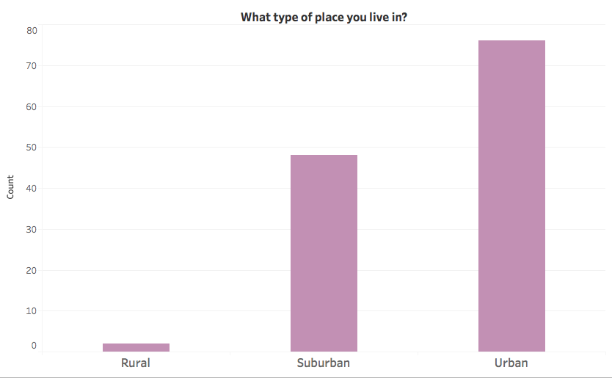
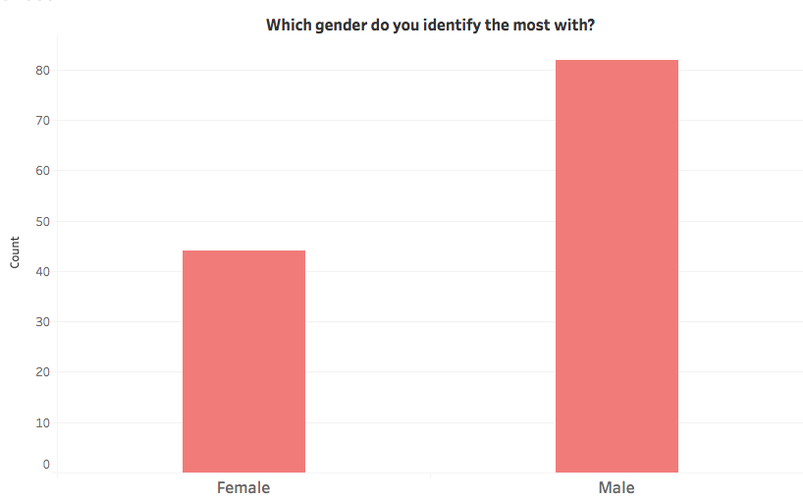
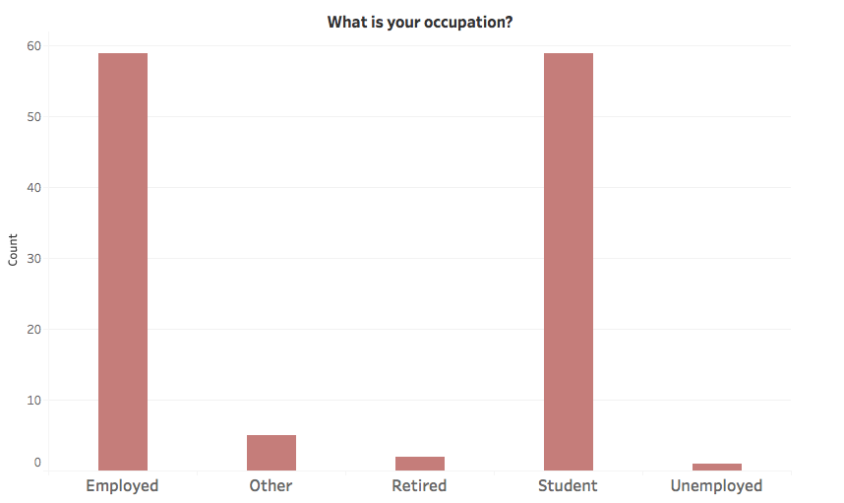
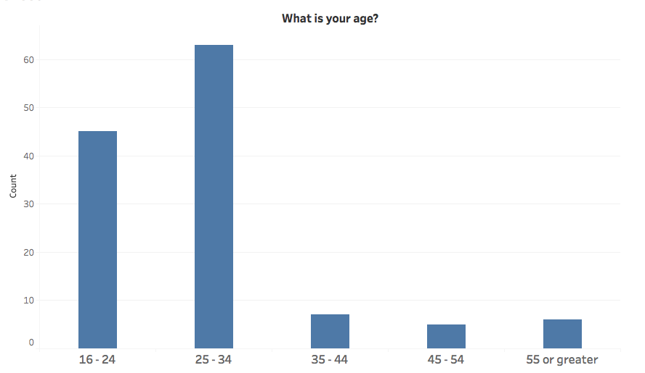
Data Analysis- Demographics

Slide 11

Data Analysis
Hypothesis Testing
NULL Hypothesis: Willingness towards riding Uber’s self driving cars is not affected by the independent variables.
Alternate Hypothesis: Willingness towards riding Uber’s self driving cars is affected by the independent variable.

Slide 12
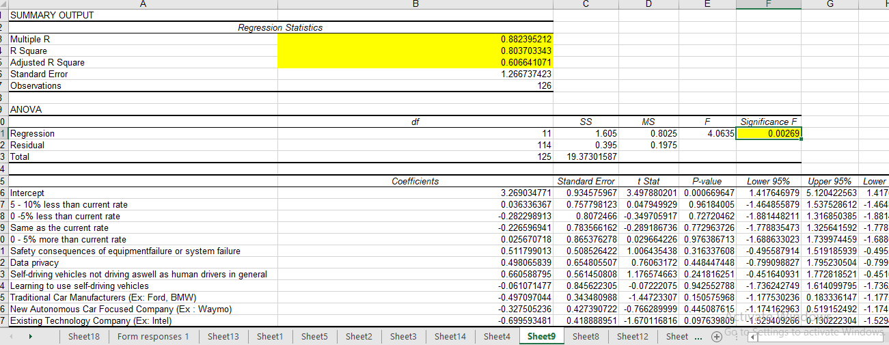
Conjoint Analysis

Slide 13

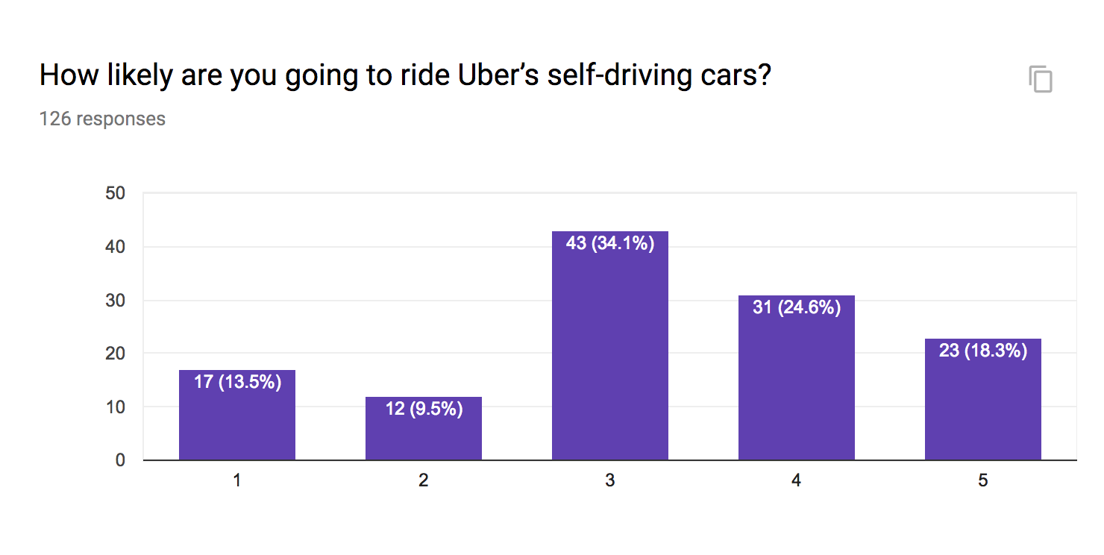
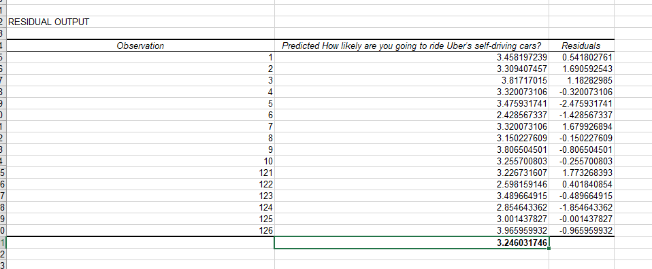
Residual Analysis- Dependent Variable
Finally, we perform the residual analysis on the observations captured in the survey in line with the conjoint analysis performed above. We get a value which is slightly above 3 on a Likert scale of 1-5, indicating that the general consensus towards such autonomous vehicles is just above neutral.

Slide 14






Summary
77% of the respondents most preferred ride sharing company is Uber
53 % trust Traditional Car Manufacturers to introduce the self-driving technology while only 14% trust ride sharing companies like Uber, Lyft to introduce it
PREFERENCE
PRICING
TRUST
Most respondents (67%) would prefer paying less than current ride price for Uber’s self-driving car
UBER
43% of the surveyors are likely to ride Uber’s self-driving car, 34% are neutral and 24% are unlikely to try it
SAFETY
ACCEPTANCE
WILLINGNESS
65% of respondents feel safety is the biggest issue for Uber’s self-driving cars followed by self-driving cars not driving as well as humans (18.4%)
57% of the respondents would be willing to ride in an Autonomous Uber for free while only 10% would be unwilling.

Slide 15

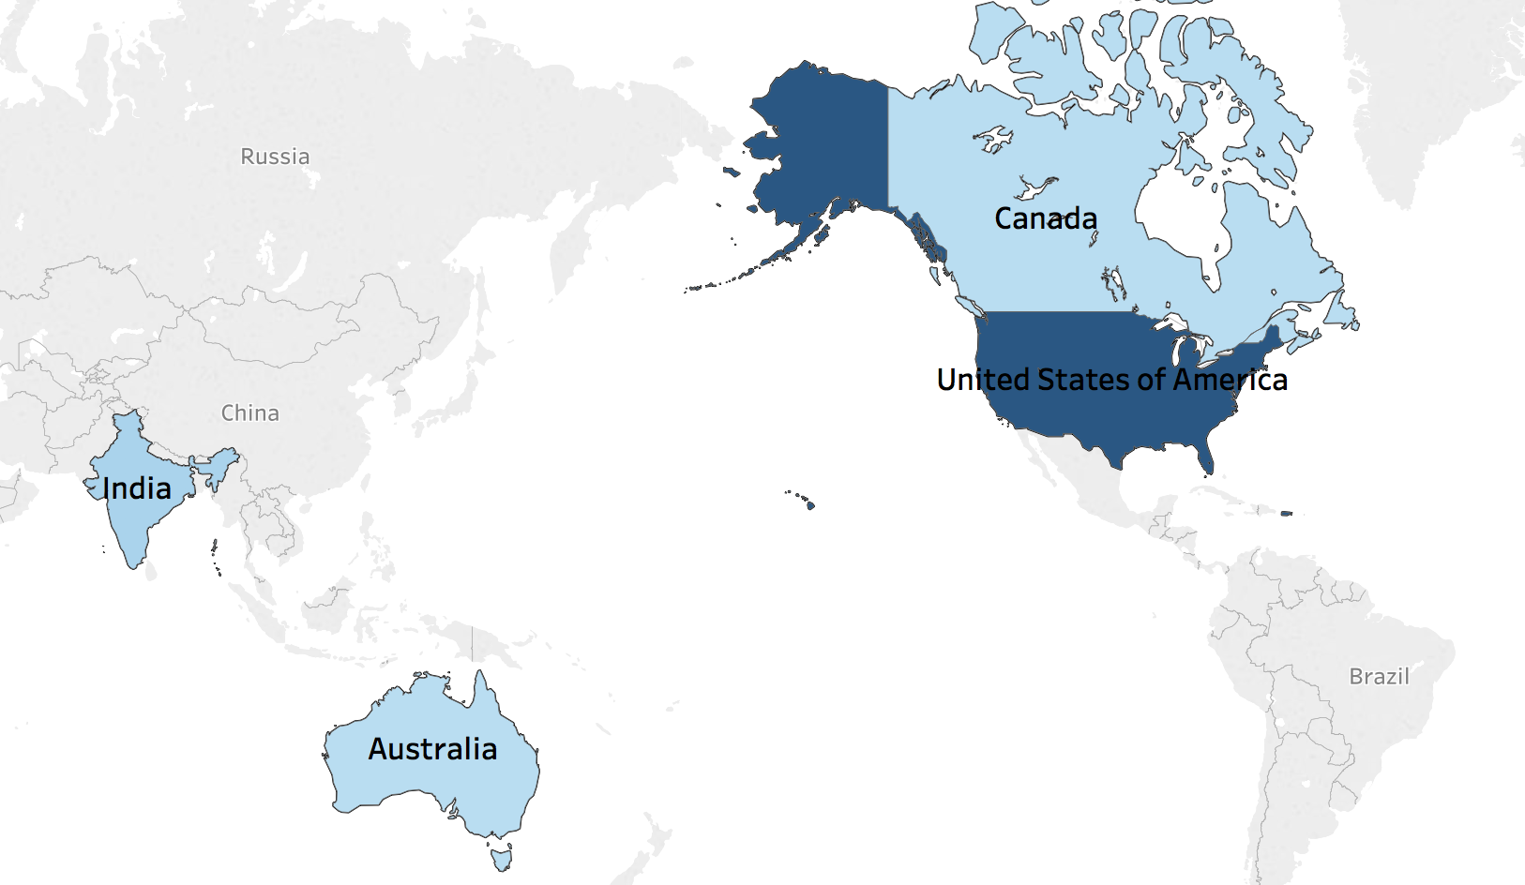
Recommendations
Uber can consider liaising with traditional car manufacturing companies specializing in safety features.
They can focus on extending autonomous car services in India, Canada and Australia.
As almost 60% of the respondents are likely to try Uber’s autonomous car services if offered for free, Uber can consider promotional activities in their business model.
At inception, Uber should consider keeping nominal pricing model in accordance with the market.

Slide 16




Conclusion
Uber is the most preferred ride hailing service
People are likely to ride Uber’s autonomous car
Safety is the biggest concern when riding in a self-driving Uber
Respondents expect to pay less in a self-driving Uber as compared to an Uber with a driver

Slide 17
Thankyou for listening !

